Slide 1

ENTERPRISE
ANALYTICS
making it
BIG

Slide 2

MAKINGG
SENSE

Slide 3

Call me - Steen
Senior partner and co-founder
15+ years of analytics
  Including log file analyzing
Google Partner Academy Trainer
Nominated as global analytics
”Practitioner of the year”
both 2014 & 2015 & ”Analytics Industy Contributor”

Slide 4

Call me - Peter
10+ years of analytics
  Including log file analyzing ;-)
19 years of web development
  7 years of Sitecore coding
  C#, SQL, HTML, CSS and the likes
Certified in Google Analytics, Adobe Analytics, Ensighten TMS, Tealium TMS, Sitecore + some
Have worked at Aller Media and
GN ReSound between 2006 and 2014, and then at IIH Nordic from 2014

Slide 5
Call us – IIH Nordic
One of the largest digital specialist
agencies and the largest analytics
agency in the Nordics
”Best Danish Analytics House” 13-16
Nominated as ”agency of the year” at the Digital Analytics Association
40 people certified i GA
15 dedicated Web Analysts
Specialists analysts in SEO, Campaign,
Conversion, PPC, Remarketing,
YouTube etc.

Slide 6
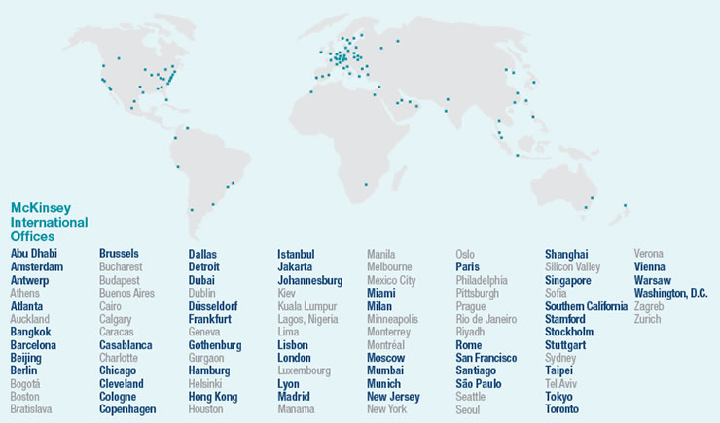
THE
ENTERPRISE

Slide 7





Challenges of Enterprise Analytics
Technical Setup
The ‘Human Factor’
User Access
Multiple sites
Data Quality

Slide 8
TECHNICAL
SETUP

Slide 9


TECHNICAL
SETUP
Data
sent to analytics
can be of mixed quality

Slide 10
TECHNICAL
SETUP
THE PAIN
Difficult to compare different sites
Data gets incorrectly inflated
Test – and production data gets mixed

Slide 11
TECHNICAL
SETUP
THE SYMPTOMS
http://www.brand.co.uk/homepage/fashion
http://www.brand.dk/home/fashion
http://www.brand.co.uk/home/fashion/footwear
http://www.brand.dk/home/fashion/shoes-boots
http://www.brand.co.uk/?query=shoes
http://www.brand.dk/?keyword=shoes

Slide 12

TECHNICAL
SETUP
THE SYMPTOMS
http://www.brand.co.uk/homepage/fashion
http://www.brand.dk/home/fashion
http://www.brand.co.uk/home/fashion/footwear
http://www.brand.dk/home/fashion/shoes-boots
http://www.brand.co.uk/?query=shoes
http://www.brand.dk/?keyword=shoes

Slide 13

TECHNICAL
SETUP
THE SYMPTOMS
http://www.brand.co.uk/homepage/fashion
http://www.brand.dk/home/fashion
http://www.brand.co.uk/home/fashion/footwear
http://www.brand.dk/home/fashion/shoes-boots
http://www.brand.co.uk/?query=shoes
http://www.brand.dk/?keyword=shoes

Slide 14

TECHNICAL
SETUP
THE SYMPTOMS
http://www.brand.co.uk/homepage/fashion
http://www.brand.dk/home/fashion
http://www.brand.co.uk/home/fashion/footwear
http://www.brand.dk/home/fashion/shoes-boots
http://www.brand.co.uk/?query=shoes
http://www.brand.dk/?keyword=shoes

Slide 15
TECHNICAL
SETUP
THE SYMPTOMS
http://www.brand.co.uk/homepage/fashion
http://www.brand.dk/home/fashion
http://www.brand.co.uk/home/fashion/footwear
http://www.brand.dk/home/fashion/shoes-boots
http://www.brand.co.uk/?query=shoes
http://www.brand.dk/?keyword=shoes

Slide 16
TECHNICAL
SETUP
REMEDY #1
Before Analytics
Send data as consistent as possible
Separate test and staging data from that of the production environment
TMS is a great help here

Slide 17
TECHNICAL
SETUP
REMEDY #2
In Analytics
Refine and clean incoming data
Lowercase, include, exclude, and in some cases rewrites
Define correct settings
Paths, search, qs params, goals ...

Slide 18
HUMAN
FACTOR

Slide 19
HUMAN
FACTOR
HUMANS
THINK DIFFERENTLY
(and act accordingly)

Slide 20
THE PAIN
HUMAN
FACTOR
Same campaigns multiple times
  Looks like different ones
  Difficult to overview
Campaigns non-functional
  Insufficiently set up

Slide 21
THE SYMPTOMS
HUMAN
FACTOR
?utm_source=Newsletter&utm_medium=e-mail&utm_campaign=octo10
?utm_source=newsletter&utm_medium=E-mail&utm_campaign=October10
?utm_source=newsleter&utm_medium=mail&utm_campaign=OCT10
?utm_source=nyhedsbrev&utm_medium=Email&utm_campaign=oktober10
Different values = different campaigns

Slide 22
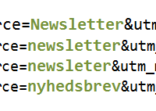
THE SYMPTOMS
HUMAN
FACTOR
?utm_source=Newsletter&utm_medium=e-mail&utm_campaign=octo10
?utm_source=newsletter&utm_medium=E-mail&utm_campaign=October10
?utm_source=newsleter&utm_medium=mail&utm_campaign=OCT10
?utm_source=nyhedsbrev&utm_medium=Email&utm_campaign=oktober10
Different values = different campaigns

Slide 23
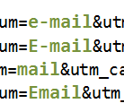
THE SYMPTOMS
HUMAN
FACTOR
?utm_source=Newsletter&utm_medium=e-mail&utm_campaign=octo10
?utm_source=newsletter&utm_medium=E-mail&utm_campaign=October10
?utm_source=newsleter&utm_medium=mail&utm_campaign=OCT10
?utm_source=nyhedsbrev&utm_medium=Email&utm_campaign=oktober10
Different values = different campaigns

Slide 24
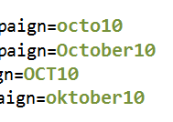
THE SYMPTOMS
HUMAN
FACTOR
?utm_source=Newsletter&utm_medium=e-mail&utm_campaign=octo10
?utm_source=newsletter&utm_medium=E-mail&utm_campaign=October10
?utm_source=newsleter&utm_medium=mail&utm_campaign=OCT10
?utm_source=nyhedsbrev&utm_medium=Email&utm_campaign=oktober10
Different values = different campaigns

Slide 25
THE SYMPTOMS
HUMAN
FACTOR
?utm_source=Newsletter&utm_medium=e-mail&utm_campaign=octo10
?utm_source=newsletter&utm_medium=E-mail&utm_campaign=October10
?utm_source=newsleter&utm_medium=mail&utm_campaign=OCT10
?utm_source=nyhedsbrev&utm_medium=Email&utm_campaign=oktober10
Different values = different campaigns

Slide 26





REMEDY #1
HUMAN
FACTOR
Tools

Slide 27

REMEDY #2
HUMAN
FACTOR
utm_id
/page1?utm_id=abc987
ga:campaignCode | ga:source | ga:medium
123abc | Winter Newsletter | email
abc987 | Summer Newsletter | email

Slide 28
USER
ACCESS

Slide 29
USER
ACCESS
Various
business units
needs access the same data,
but with
different angles
or access levels

Slide 30

USER
ACCESS
THE PAIN
Analytics users’ access
  Wrong data
  Too much data
  Not enough data

Slide 31

USER
ACCESS
REMEDY #1
Rollups
  Make use of rollups per country, business unit, brand or something else

Slide 32
USER
ACCESS
REMEDY #1

Slide 33


USER
ACCESS
REMEDY #2
API
  Control access to analytics through API

Slide 34
MULTIPLE
SITES

Slide 35
MULTIPLE
SITES
Demands
to analytics implementations
differ
from website to website

Slide 36

MULTIPLE
SITES
THE PAIN
Cookies are not allowed before a policy has been seen by the users

Slide 37

MULTIPLE
SITES
A REMEDY
Use a TMS to connect cookie-less tracking with normal cookie tracking
+

Slide 38
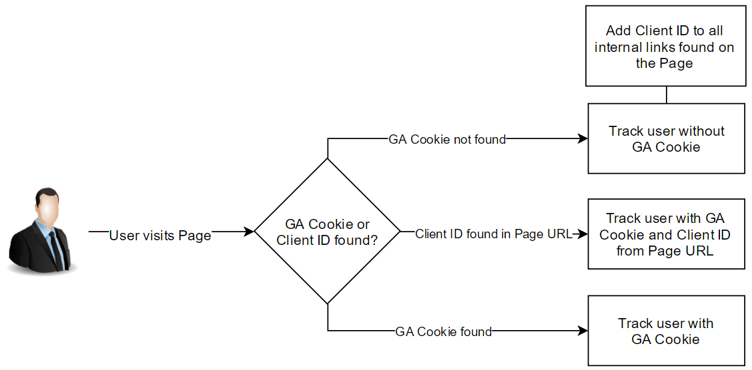
MULTIPLE
SITES
A REMEDY
First visited page tracked without a cookie

Slide 39
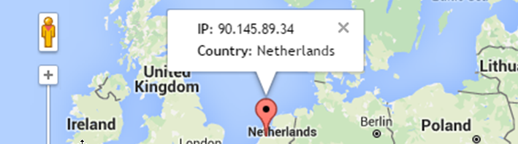
MULTIPLE
SITES
THE PAIN
For some countries you need to anonymize users

Slide 40

MULTIPLE
SITES
A REMEDY
Use a TMS
to anonymize users

Slide 41
DATA
QUALITY

Slide 42
DATA
QUALITY
Site changes tend to happen, without the web analysts knowing it

Slide 43

DATA
QUALITY
THE PAIN
Pages and functionality
  Not tracked
  Tracked incorrectly
Unknown tags on site
Data Quality uncertain

Slide 44

DATA
QUALITY
REMEDY #1
Analytics Alerts
Use Analytics Alerts to inform you about important data changes

Slide 45



DATA
QUALITY
REMEDY #2
Test and Audit tool
Added bonus:
Find tags not supposed to be there

Slide 46
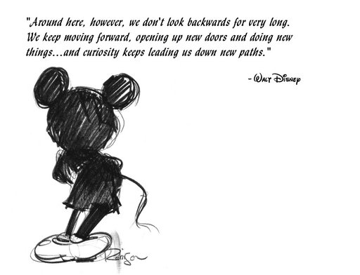
THE
BIG PICTURE

Slide 47
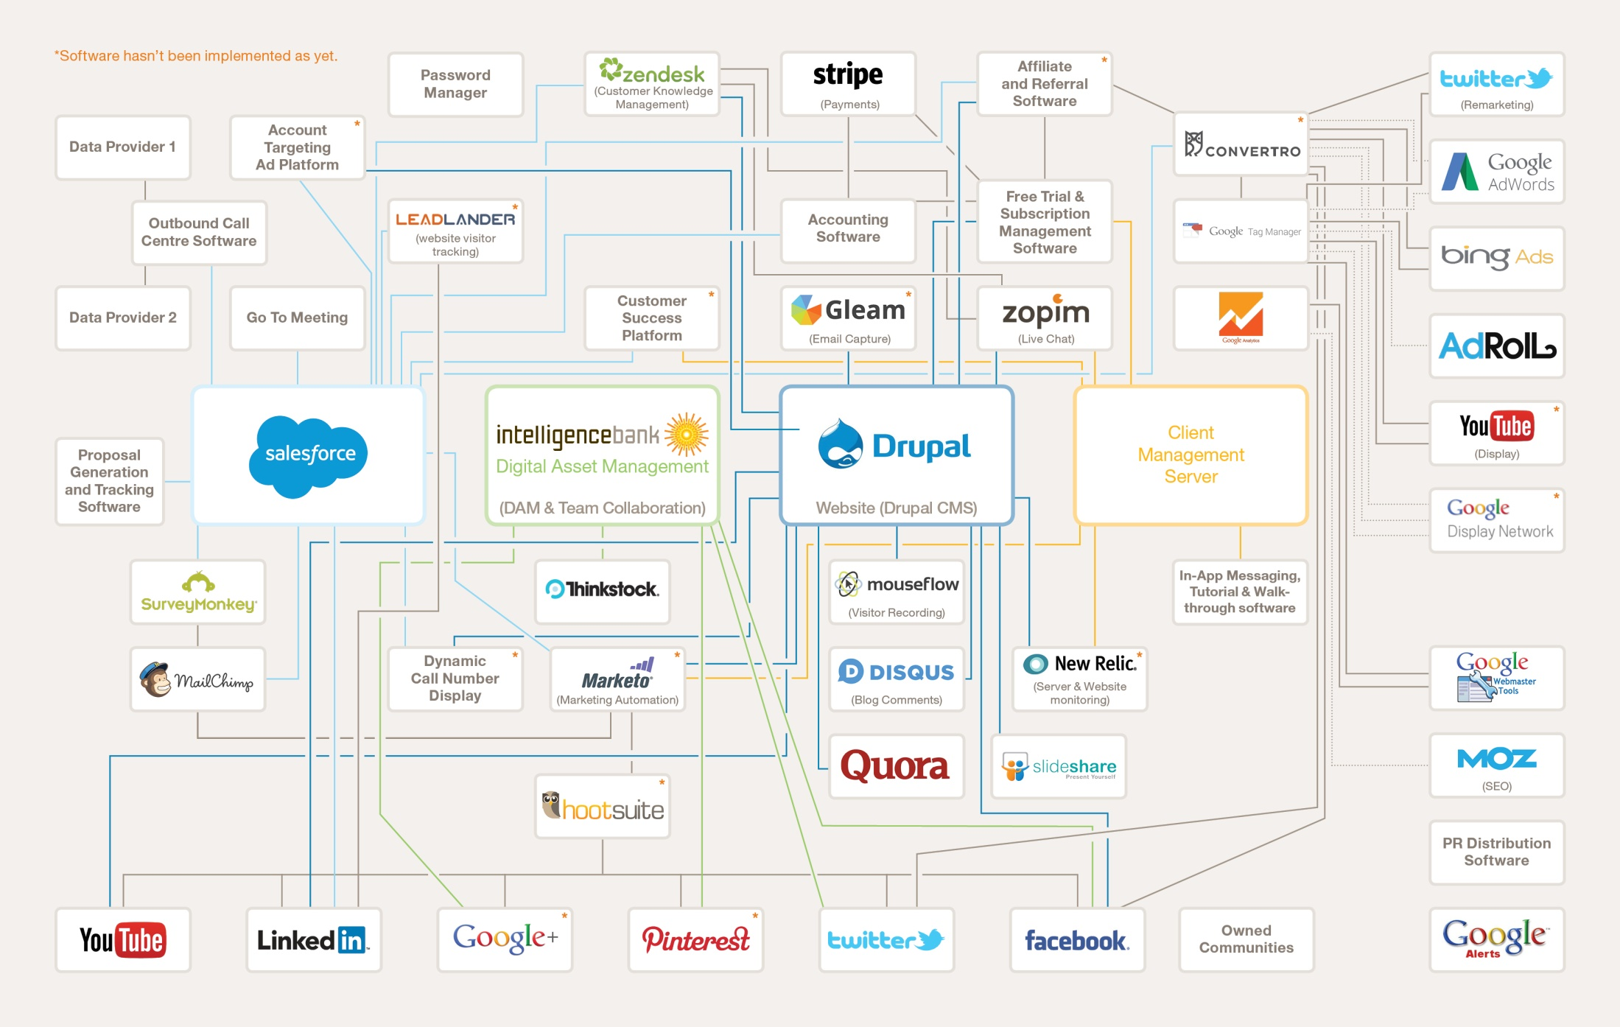
The MarTec Stack

Slide 49
Challenges of Enterprise Analytics
Technical Setup
The ‘Human Factor’
User Access
Multiple sites
Data Quality

Slide 50

Peter Meyer
Senior Web Analytics Technician
(+45) 70 20 29 19
peter.meyer@iihnordic.com
www.iihnordic.dk
dk.linkedin.com/in/pmeyerdk
Steen Rasmussen
Senior Partner
(+45) 70 20 29 19
steen@iihnordic.com
www.iihnordic.dk
dk.linkedin.com/in/steenrasmussen

