Slide 2
Jim Sterne
eMetrics Summit
Digital Analytics Association

Slide 3
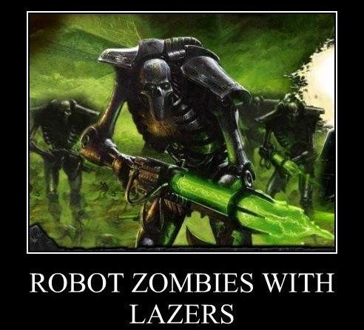
Jim Sterne – emetrics.org – @jimsterne – #spwk

Slide 4
Jim Sterne – emetrics.org – @jimsterne – #spwk

Slide 5
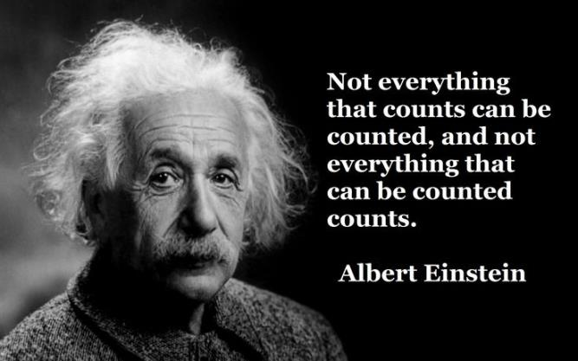
Einstein Was Wrong
Jim Sterne – emetrics.org – @jimsterne – #spwk

Slide 6
Einstein Was Wrong

Slide 7
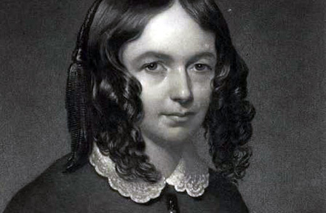
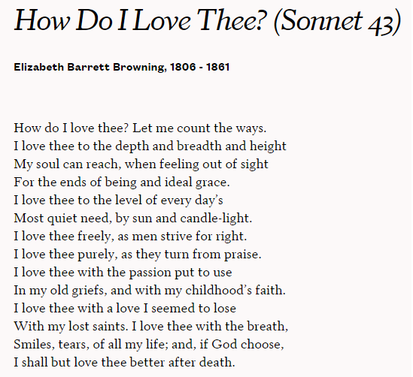
1
2
3
4
5
6
7
8
9
10
11
12
13
14
15
Jim Sterne – jsterne@targeting.com – emetrics.org – @jimsterne – #eMetrics

Slide 8
Einstein Was Wrong

Slide 9
Einstein Was Wrong

Slide 10
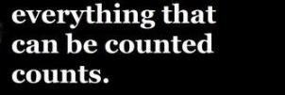
What can be counted?

Slide 11
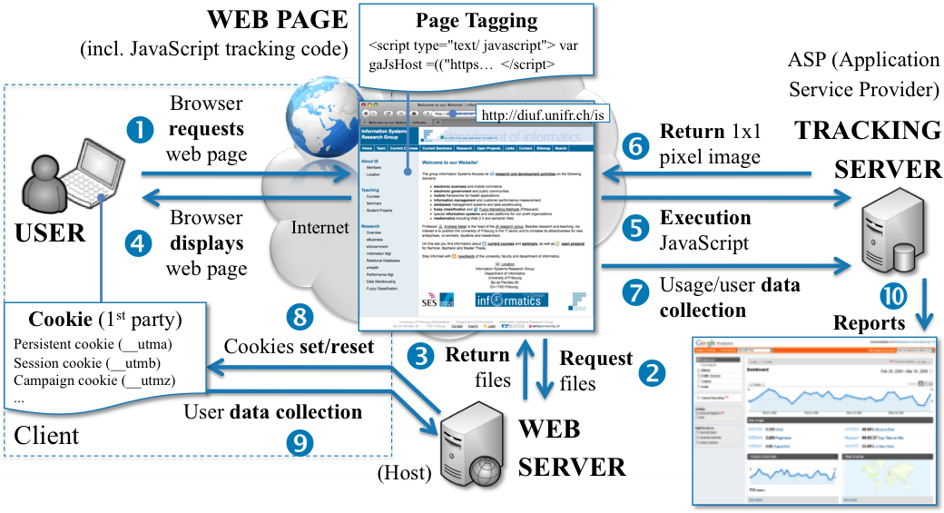
What can be counted?

Slide 12
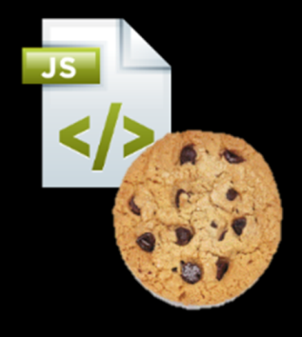
What can be counted?
Clickthroughs Pageviews
Visitors Stickiness
Attribution Conversion
Bounce Rate Path Analysis
View Throughs Abandonment

Slide 13
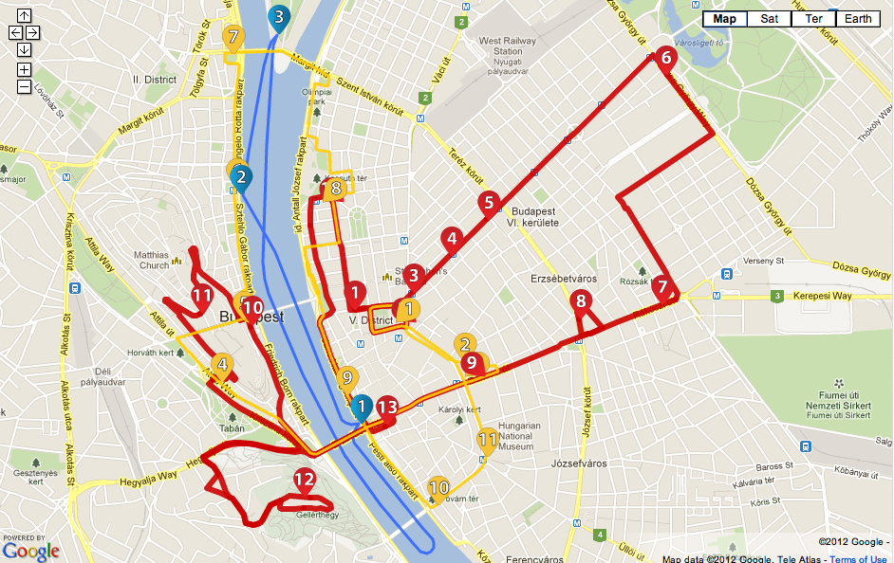
What can be counted?
identity
domain name
Clickthroughs Pageviews
Visitors Stickiness
Attribution Conversion
Bounce Rate Path Analysis
View Throughs Abandonment
Clickthroughs Pageviews
Visitors Stickiness
Attribution Conversion
Bounce Rate Path Analysis
View Throughs Abandonment
Recency Postal Address
Frequency Credit Card
Preferences Phone Number
Recency Postal Address
Frequency Credit Card
Preferences Phone Number

Slide 14
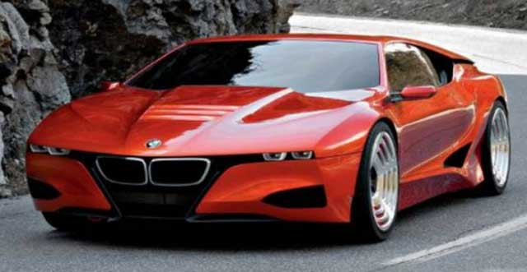
What can be counted?
identity
domain name
Clickthroughs Pageviews
Visitors Stickiness
Attribution Conversion
Bounce Rate Path Analysis
View Throughs Abandonment
Clickthroughs Pageviews
Visitors Stickiness
Attribution Conversion
Bounce Rate Path Analysis
View Throughs Abandonment
Recency Postal Address
Frequency Credit Card
Preferences Phone Number
Recency Postal Address
Frequency Credit Card
Preferences Phone Number
Location-at-the-moment

Slide 15
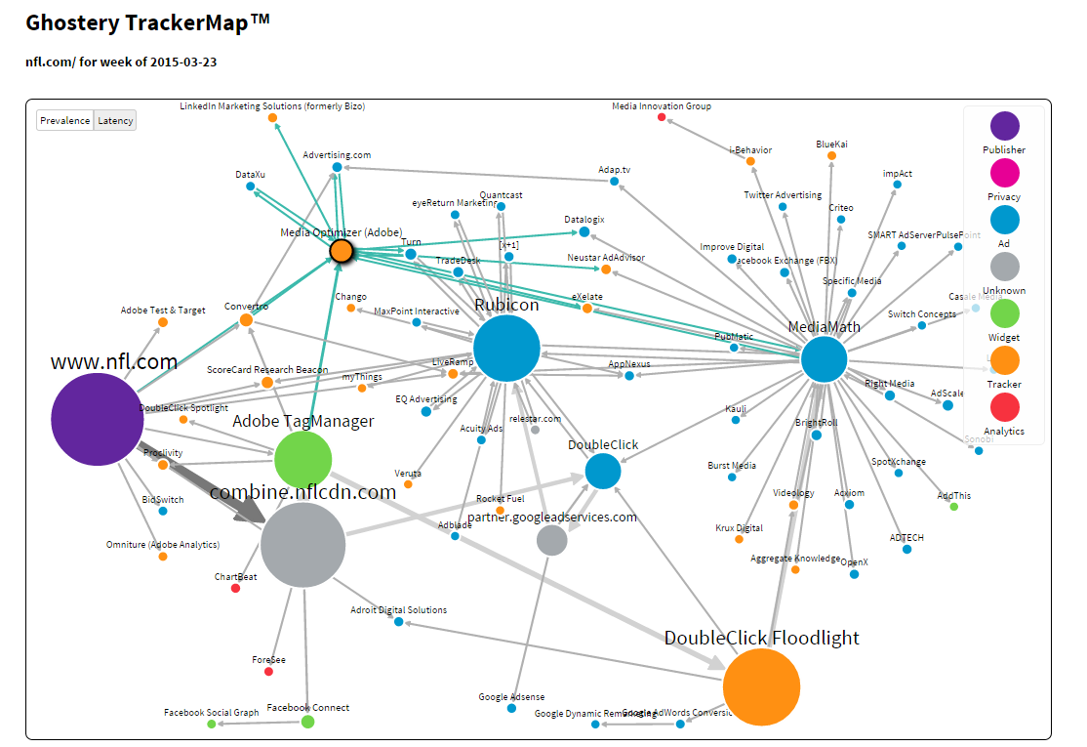
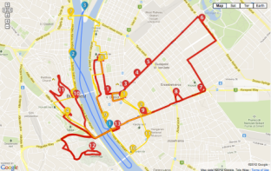
What can be counted?
identity
domain name
Clickthroughs Pageviews
Visitors Stickiness
Attribution Conversion
Bounce Rate Path Analysis
View Throughs Abandonment
Clickthroughs Pageviews
Visitors Stickiness
Attribution Conversion
Bounce Rate Path Analysis
View Throughs Abandonment
Recency Postal Address
Frequency Credit Card
Preferences Phone Number
Recency Postal Address
Frequency Credit Card
Preferences Phone Number
Location-at-the-moment

Slide 16
What can be counted?
identity
domain name
Clickthroughs Pageviews
Visitors Stickiness
Attribution Conversion
Bounce Rate Path Analysis
View Throughs Abandonment
Clickthroughs Pageviews
Visitors Stickiness
Attribution Conversion
Bounce Rate Path Analysis
View Throughs Abandonment
Recency Postal Address
Frequency Credit Card
Preferences Phone Number
Recency Postal Address
Frequency Credit Card
Preferences Phone Number
Location-at-the-moment

Slide 17
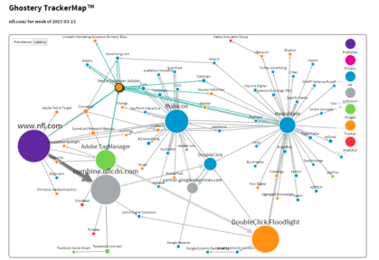
What can be counted?
identity
domain name
Clickthroughs Pageviews
Visitors Stickiness
Attribution Conversion
Bounce Rate Path Analysis
View Throughs Abandonment
Clickthroughs Pageviews
Visitors Stickiness
Attribution Conversion
Bounce Rate Path Analysis
View Throughs Abandonment
Recency Postal Address
Frequency Credit Card
Preferences Phone Number
Recency Postal Address
Frequency Credit Card
Preferences Phone Number
Location-at-the-moment
Axiom
1,500 attributes
500 million people
3,000 propensities
90% social profiles

Slide 18
What can be counted?
identity
domain name
Clickthroughs Pageviews
Visitors Stickiness
Attribution Conversion
Bounce Rate Path Analysis
View Throughs Abandonment
Clickthroughs Pageviews
Visitors Stickiness
Attribution Conversion
Bounce Rate Path Analysis
View Throughs Abandonment
Recency Postal Address
Frequency Credit Card
Preferences Phone Number
Recency Postal Address
Frequency Credit Card
Preferences Phone Number
Location-at-the-moment

Slide 19
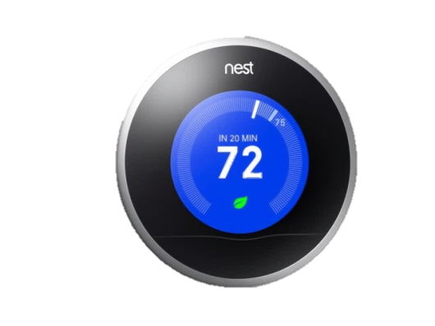
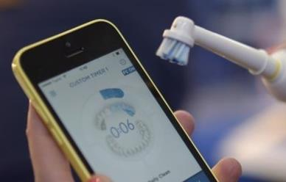
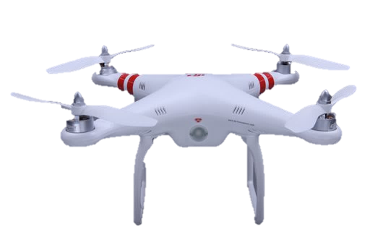
What can be counted?
identity
domain name
Clickthroughs Pageviews
Visitors Stickiness
Attribution Conversion
Bounce Rate Path Analysis
View Throughs Abandonment
Clickthroughs Pageviews
Visitors Stickiness
Attribution Conversion
Bounce Rate Path Analysis
View Throughs Abandonment
Recency Postal Address
Frequency Credit Card
Preferences Phone Number
Recency Postal Address
Frequency Credit Card
Preferences Phone Number
Location-at-the-moment
My health
My fitness
My sleep habits
My medications
My driving habits
My blood alcohol level
My ability to walk in a straight line

Slide 21
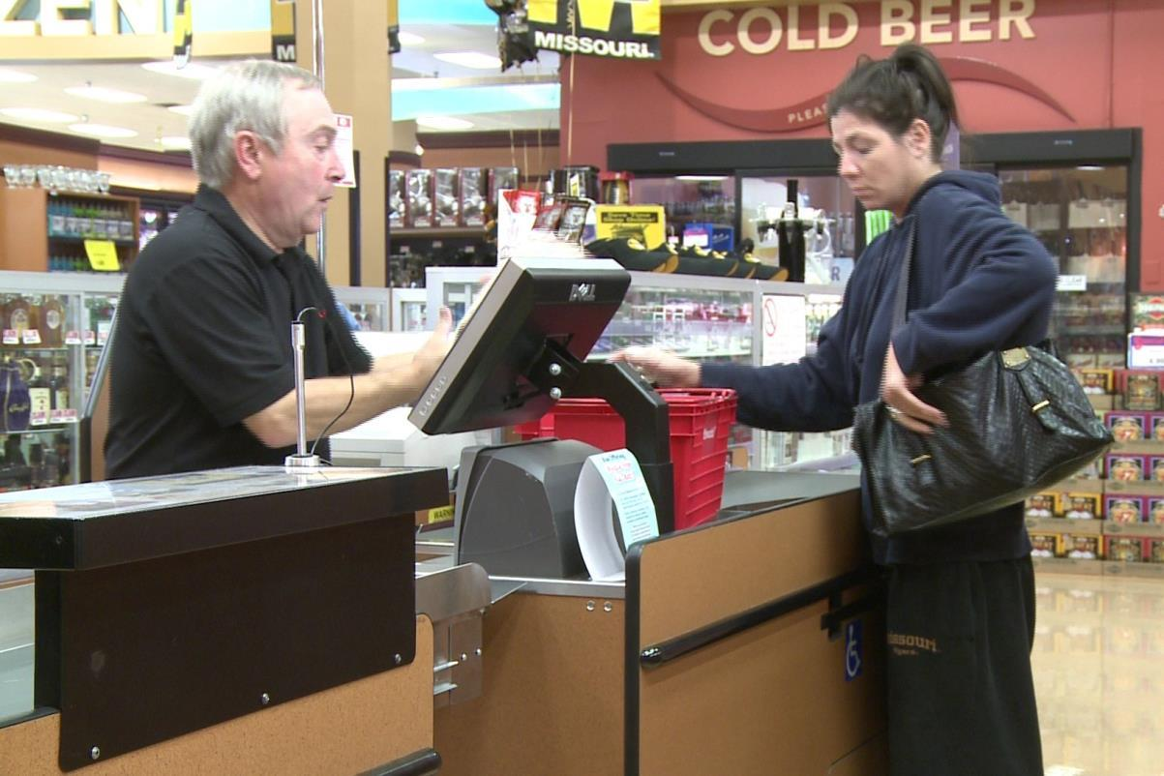
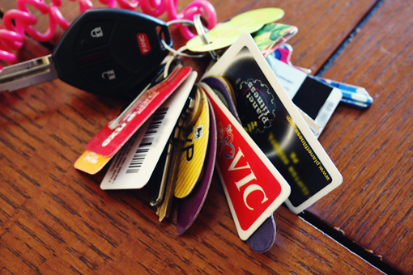
What can be counted?

Slide 22
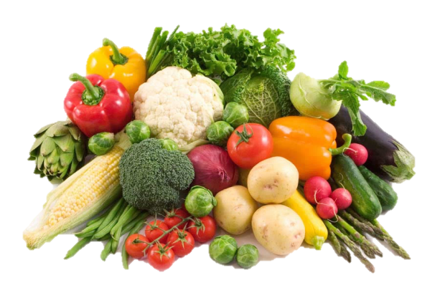
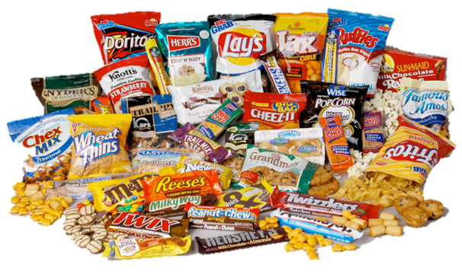
What can be counted?

Slide 23
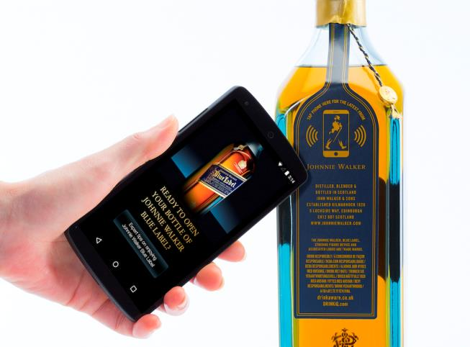
What can be counted?

Slide 24
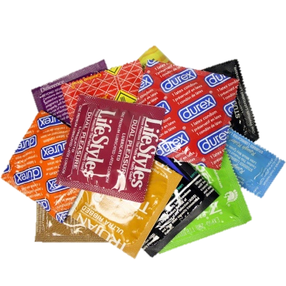
What can be counted?

Slide 25
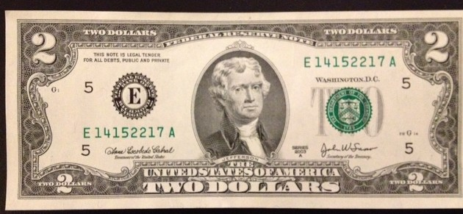
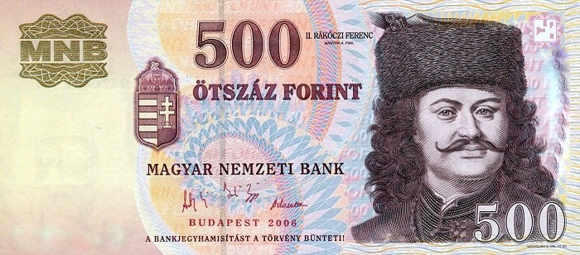
What can be counted?
Negotiating with data

Slide 26
What can be counted?
identity
domain name
Clickthroughs Pageviews
Visitors Stickiness
Attribution Conversion
Bounce Rate Path Analysis
View Throughs Abandonment
Clickthroughs Pageviews
Visitors Stickiness
Attribution Conversion
Bounce Rate Path Analysis
View Throughs Abandonment
Recency Postal Address
Frequency Credit Card
Preferences Phone Number
Recency Postal Address
Frequency Credit Card
Preferences Phone Number
Location-at-the-moment
My health
My fitness
My sleep habits
My medications
My driving habits
My blood alcohol level
My ability to walk in a straight line

Slide 27
Big data
Jim Sterne – jsterne@targeting.com – emetrics.org – @jimsterne – #eMetrics

Slide 28
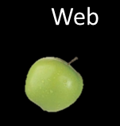
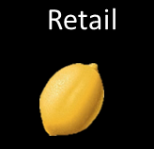
Big data
Jim Sterne – jsterne@targeting.com – emetrics.org – @jimsterne – #eMetrics

Slide 29
Jeff’ Bezos' Memo
“All teams will henceforth expose their data and functionality through service interfaces.
Teams must communicate with each other through these interfaces.
There will be no other form of inter-process communication allowed: no direct linking, no direct reads of another team’s data store, no shared memory model, no back-doors whatsoever. The only communication allowed is via service interface calls over the network.
It doesn’t matter what technology they use.
All service interfaces, without exception, must be designed from the ground up to be externalizable. That is to say, the team must plan and design to be able to expose the interface to developers in the outside world. No exceptions.
@timoreilly
#BitcoinSummit
29
Notes:
With characteristic insight and decisiveness, Jeff thought through what this meant, and then had the discipline to rebuild his company as a platform. As reported in Steve Yegge’s Platform Rant https://plus.google.com/+RipRowan/posts/eVeouesvaVX, he wrote a memo that went something like this.

Slide 30
Jeff’ Bezos' Memo
“All teams will henceforth expose their data and functionality through service interfaces.
Teams must communicate with each other through these interfaces.
There will be no other form of inter-process communication allowed: no direct linking, no direct reads of another team’s data store, no shared memory model, no back-doors whatsoever. The only communication allowed is via service interface calls over the network.
It doesn’t matter what technology they use.
All service interfaces, without exception, must be designed from the ground up to be externalizable. That is to say, the team must plan and design to be able to expose the interface to developers in the outside world. No exceptions.
@timoreilly
#BitcoinSummit
30
Notes:
With characteristic insight and decisiveness, Jeff thought through what this meant, and then had the discipline to rebuild his company as a platform. As reported in Steve Yegge’s Platform Rant https://plus.google.com/+RipRowan/posts/eVeouesvaVX, he wrote a memo that went something like this.

Slide 31
Jeff’ Bezos' Memo
“All teams will henceforth expose their data and functionality through service interfaces.
Teams must communicate with each other through these interfaces.
There will be no other form of inter-process communication allowed: no direct linking, no direct reads of another team’s data store, no shared memory model, no back-doors whatsoever. The only communication allowed is via service interface calls over the network.
It doesn’t matter what technology they use.
All service interfaces, without exception, must be designed from the ground up to be externalizable. That is to say, the team must plan and design to be able to expose the interface to developers in the outside world. No exceptions.
@timoreilly
#BitcoinSummit
31
Notes:
With characteristic insight and decisiveness, Jeff thought through what this meant, and then had the discipline to rebuild his company as a platform. As reported in Steve Yegge’s Platform Rant https://plus.google.com/+RipRowan/posts/eVeouesvaVX, he wrote a memo that went something like this.

Slide 32
Jeff’ Bezos' Memo
“All teams will henceforth expose their data and functionality through service interfaces.
Teams must communicate with each other through these interfaces.
There will be no other form of inter-process communication allowed: no direct linking, no direct reads of another team’s data store, no shared memory model, no back-doors whatsoever. The only communication allowed is via service interface calls over the network.
It doesn’t matter what technology they use.
All service interfaces, without exception, must be designed from the ground up to be externalizable. That is to say, the team must plan and design to be able to expose the interface to developers in the outside world. No exceptions.
@timoreilly
#BitcoinSummit
32
Notes:
With characteristic insight and decisiveness, Jeff thought through what this meant, and then had the discipline to rebuild his company as a platform. As reported in Steve Yegge’s Platform Rant https://plus.google.com/+RipRowan/posts/eVeouesvaVX, he wrote a memo that went something like this.

Slide 33
Jeff’ Bezos' Memo
“All teams will henceforth expose their data and functionality through service interfaces.
Teams must communicate with each other through these interfaces.
There will be no other form of inter-process communication allowed: no direct linking, no direct reads of another team’s data store, no shared memory model, no back-doors whatsoever. The only communication allowed is via service interface calls over the network.
It doesn’t matter what technology they use.
All service interfaces, without exception, must be designed from the ground up to be externalizable. That is to say, the team must plan and design to be able to expose the interface to developers in the outside world. No exceptions.
@timoreilly
#BitcoinSummit
33
Notes:
With characteristic insight and decisiveness, Jeff thought through what this meant, and then had the discipline to rebuild his company as a platform. As reported in Steve Yegge’s Platform Rant https://plus.google.com/+RipRowan/posts/eVeouesvaVX, he wrote a memo that went something like this.

Slide 34
Jeff’ Bezos' Memo
“All teams will henceforth expose their data and functionality through service interfaces.
Teams must communicate with each other through these interfaces.
There will be no other form of inter-process communication allowed: no direct linking, no direct reads of another team’s data store, no shared memory model, no back-doors whatsoever. The only communication allowed is via service interface calls over the network.
It doesn’t matter what technology they use.
All service interfaces, without exception, must be designed from the ground up to be externalizable. That is to say, the team must plan and design to be able to expose the interface to developers in the outside world. No exceptions.
@timoreilly
#BitcoinSummit
34
Notes:
With characteristic insight and decisiveness, Jeff thought through what this meant, and then had the discipline to rebuild his company as a platform. As reported in Steve Yegge’s Platform Rant https://plus.google.com/+RipRowan/posts/eVeouesvaVX, he wrote a memo that went something like this.

Slide 35
Jeff’ Bezos' Memo
“All teams will henceforth expose their data and functionality through service interfaces.
Teams must communicate with each other through these interfaces.
There will be no other form of inter-process communication allowed: no direct linking, no direct reads of another team’s data store, no shared memory model, no back-doors whatsoever. The only communication allowed is via service interface calls over the network.
It doesn’t matter what technology they use.
All service interfaces, without exception, must be designed from the ground up to be externalizable. That is to say, the team must plan and design to be able to expose the interface to developers in the outside world. No exceptions.
@timoreilly
#BitcoinSummit
35
Notes:
With characteristic insight and decisiveness, Jeff thought through what this meant, and then had the discipline to rebuild his company as a platform. As reported in Steve Yegge’s Platform Rant https://plus.google.com/+RipRowan/posts/eVeouesvaVX, he wrote a memo that went something like this.

Slide 36
Jeff’ Bezos' Memo
“All teams will henceforth expose their data and functionality through service interfaces.
Teams must communicate with each other through these interfaces.
There will be no other form of inter-process communication allowed: no direct linking, no direct reads of another team’s data store, no shared memory model, no back-doors whatsoever. The only communication allowed is via service interface calls over the network.
It doesn’t matter what technology they use.
All service interfaces, without exception, must be designed from the ground up to be externalizable. That is to say, the team must plan and design to be able to expose the interface to developers in the outside world. No exceptions.
Anyone who doesn’t do this will be fired."
@timoreilly
#BitcoinSummit
36
Notes:
With characteristic insight and decisiveness, Jeff thought through what this meant, and then had the discipline to rebuild his company as a platform. As reported in Steve Yegge’s Platform Rant https://plus.google.com/+RipRowan/posts/eVeouesvaVX, he wrote a memo that went something like this.

Slide 37
Do You Know What Data You Have?

Slide 38
Comparative Trustworthiness of Each Variable
Valid
Credible
Reliable
Consistent
Clean
Unbiased
Defined
Relevant
Correlate-able
Understandable
Complete
Timely

Slide 39
Comparative Trustworthiness of Each Variable
High
Trust
Low
Trust
No
Trust

Slide 40
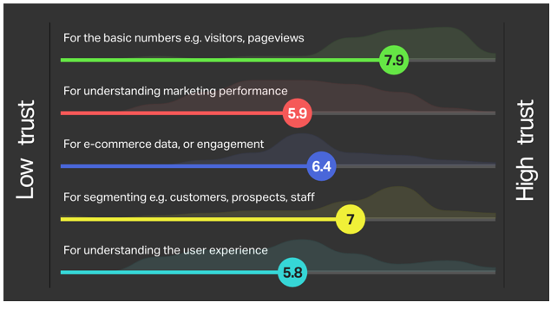
Comparative Trustworthiness of Each Variable
@BrianClifton 10/2015

Slide 41
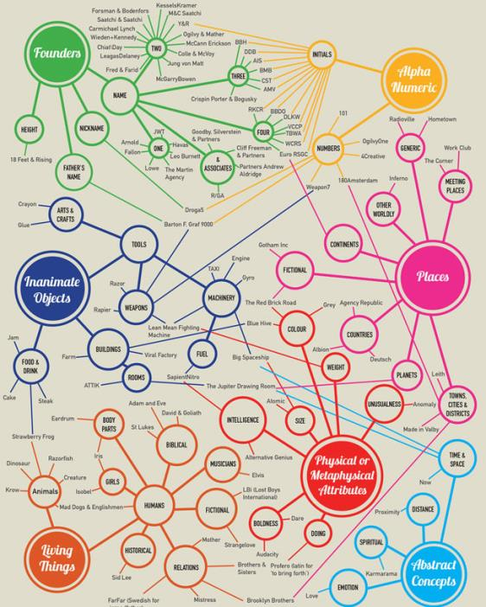
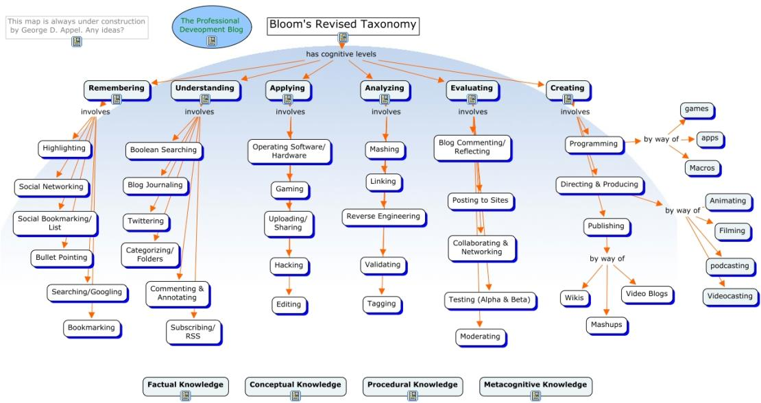
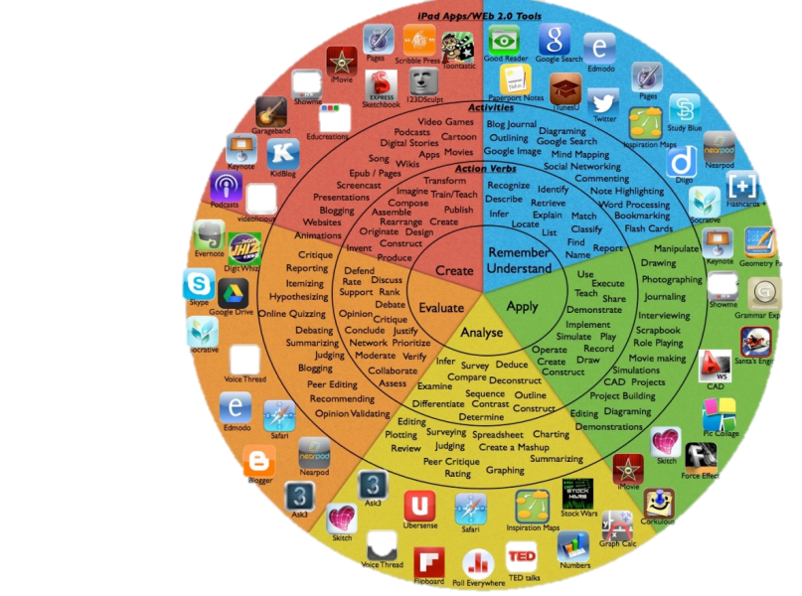
Taxonomy
Do You Know What Data You Have?

Slide 42
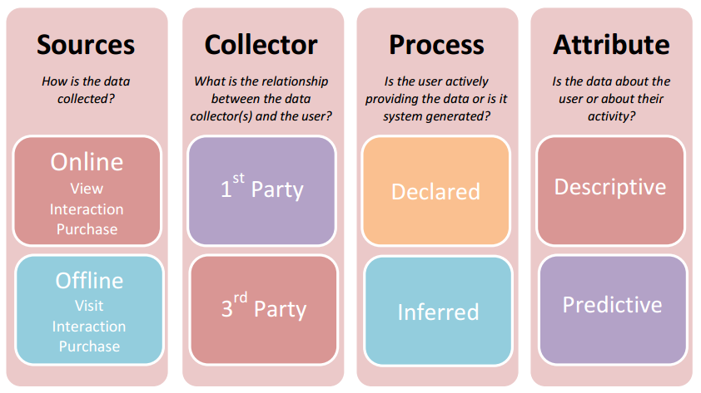

Slide 43
A Customer Data Taxonomy
Who They Are
What They Like
What They Do
What They Did
What They Have
How They Feel
Identity
History
Proclivities
Possessions
Activities
Beliefs

Slide 44
A Customer Data Taxonomy
Who They Are
Name
Gender
Age
Race
Address
Phone
Fingerprint
Weight
Gait
Government ID
etc.
Identity

Slide 45
A Customer Data Taxonomy
Education
Career
Criminal Record
Press exposure
Publications
Awards
Associations
Credit score
Loans
Divorce
etc.
What They Did
History

Slide 46
A Customer Data Taxonomy
What They Like
Preferences
Settings
Avocations
Political Party
Social Likes
Entertainment
Hobbies
News feeds
Browser history
Brand affinity
etc.
Proclivities

Slide 47
A Customer Data Taxonomy
Income
Home
Cars
Devices
Clothing
Jewelry
Investments
Memberships
Collections
Relationships
etc.
What They Have
Possessions

Slide 48
A Customer Data Taxonomy
What They Do
Keystrokes
Gestures
Eye tracking
Day part
Location
Social posts
Dining out
Purchases
Commute
TV viewing
etc.
Activities

Slide 49
A Customer Data Taxonomy
Religion
Values
Donations
Skepticism / Altruism
Introvert / Extrovert
Generous / Miserly
Adaptive / Inflexible
Aggressive / Passive
Opinion
Mood
etc.
How They Feel
Beliefs

Slide 50
A Customer Data Taxonomy
Who They Are
What They Like
What They Do
What They Did
What They Have
How They Feel
Identity
History
Proclivities
Possessions
Activities
Beliefs

Slide 51
A Customer Data Taxonomy
Who They Are
What They Like
What They Do
What They Did
What They Have
How They Feel
Provided
Identity
History
Proclivities
Possessions
Activities
Beliefs
Observed
Derived
Inferred
Based on: “The Origins of Personal Data and its Implications for Governance” By Martin Abrams, The Information Accountability Foundation, 21 March 2014”

Slide 52
A Customer Data Taxonomy
Who They Are
What They Like
What They Do
What They Did
What They Have
How They Feel
Provided
Identity
History
Proclivities
Possessions
Activities
Beliefs
Application Survey Posted Photos
Preferences Purchase Posted Location
Observed
Cookie/Java Toll Camera CCTV Camera
Loyalty Card Mouse Hover iBeacon
Derived
Average Spend Profitability Order Value
Time on Site Spend per Visit Cust. Segment by Age
Inferred
Credit Score Life Expectancy Next Best Offer
Lifetime Value Attrition Risk Purchase Propensity
Based on: “The Origins of Personal Data and its Implications for Governance” By Martin Abrams, The Information Accountability Foundation, 21 March 2014”

Slide 53
A Customer Data Taxonomy
Who They Are
What They Like
What They Do
What They Did
What They Have
How They Feel
Initiated
Transacted
Posted
Provided
Identity
History
Proclivities
Possessions
Activities
Beliefs
Application Survey Posted Photos
Preferences Purchase Posted Location
Engaged
Unforeseen
Passive
Observed
Cookie/Java Toll Camera CCTV Camera
Loyalty Card Mouse Hover iBeacon
Computational
Notational
Derived
Average Spend Profitability Order Value
Time on Site Spend per Visit Cust. Segment by Age
Statistical
Analytical
Inferred
Credit Score Life Expectancy Next Best Offer
Lifetime Value Attrition Risk Purchase Propensity
Based on: “The Origins of Personal Data and its Implications for Governance” By Martin Abrams, The Information Accountability Foundation, 21 March 2014”

Slide 54
A Customer Data Taxonomy
Who They Are
What They Like
What They Do
What They Did
What They Have
How They Feel
Identity
History
Proclivities
Possessions
Activities
Beliefs
Missing
Dark

Slide 55
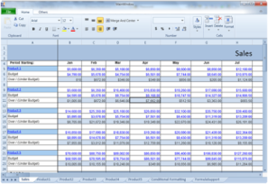
A Customer Data Taxonomy
Who They Are
What They Like
What They Do
What They Did
What They Have
How They Feel
Identity
History
Proclivities
Possessions
Activities
Beliefs
Dark

Slide 56
A Customer Data Taxonomy
Who They Are
What They Like
What They Do
What They Did
What They Have
How They Feel
Identity
History
Proclivities
Possessions
Activities
Beliefs

Slide 57
Do You Know What Data You Have?
Data Protection
Data Ethics
Privacy
Don't Be Evil

Slide 58
What Data Matters?
It depends –
What are your goals?

Slide 59
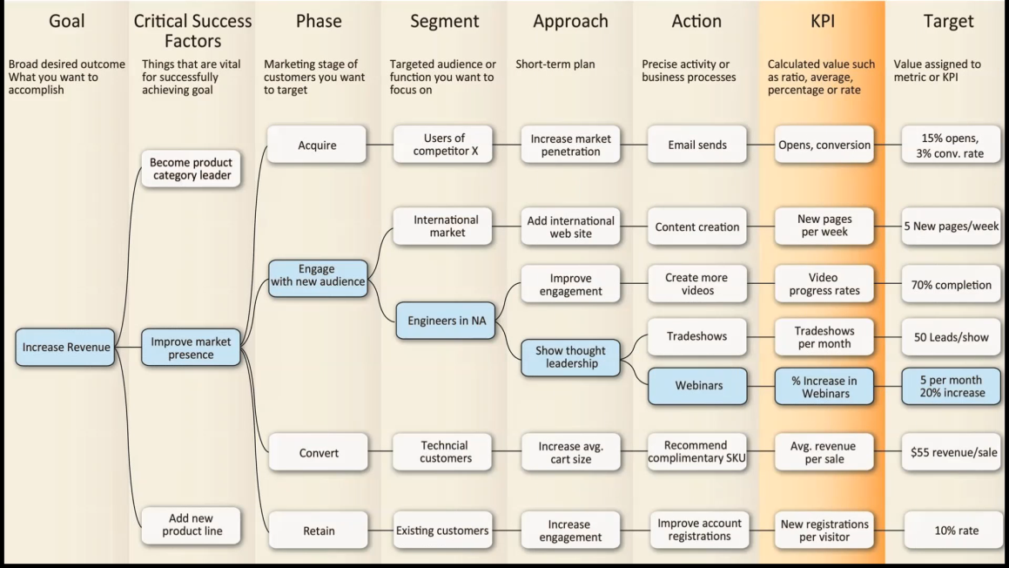
KPIKarta.com

Slide 60
Stephen Few
http://www.perceptualedge.com/blog/?p=820

Slide 61
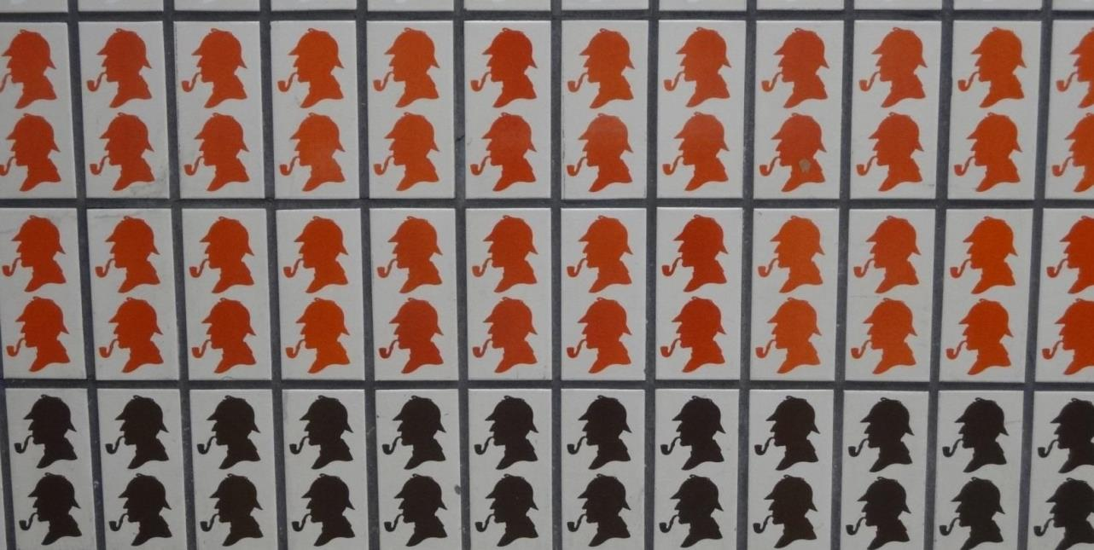

Slide 62
Creativity
The True Art of Analysis
Is there a pattern?
Is there an anomaly?
What can be omitted?
What if we did it backwards?
What if we look at it sideways?
What if we changed the time scale?
What additional data would be revealing?
What if it had wheels?
What would Chuck Norris do?
Is Superman or Batman the better analyst?
But...

Slide 63
Big data
More data than a human can wrangle
More attributes than a human can manage
More permutations than a human can comprehend
Notes:
How do you get there? Depends on where you are today

Slide 65
Machine Learning

Slide 66
Machine Learning
Awesomeness Scale
ROI
Only needs to be 3-4% better than guessing
Excel Model
Excel Calc

Slide 67
Machine Learning
CaRT
Classification and Regression Tree
Gender
M
F
Age A Age B Age C

Slide 68
Machine Learning

Slide 69
Machine Learning
Awesomeness Scale
Machine Discovers Patterns
Excel Model
Excel Calc

Slide 70
Machine Learning
Online buying goes up when the weather is bad

Slide 71
Correlation ≠ Causation

Slide 73
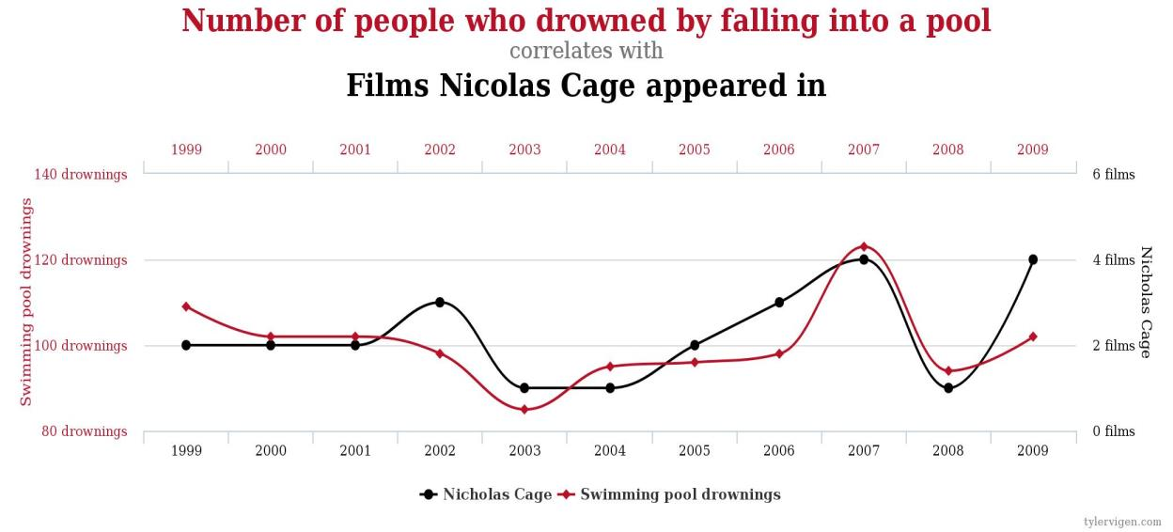

Slide 74
Machine Learning
Online buying goes up when the weather is bad
Ice cream causes drowning
Shoes cause headaches
Nicolas Cage is a monster

Slide 75
Machine Learning
There is a correlation between weather and online buying
There is a correlation between ice cream and drowning
There is a correlation between shoes and headaches
There is a correlation between Nicolas Cage and drowning

Slide 76
Machine Learning
There is a correlation between
sending branding message 26b
to customers of type 83h
after they have viewed products 13 and 62
and
an increase of cart value of 113%

Slide 77
Machine Learning
Awesomeness Scale
message 26b and increase in cart value
weather and online buying
ice cream and drowning
shoes and headaches
Machine Ranks Patterns
Machine Discovers Patterns
Excel Model
Excel Calc

Slide 78
Machine Learning
Awesomeness Scale
Machine Acts on Patterns
Machine Ranks Patterns
Machine Discovers Patterns
Excel Model
Excel Calc

Slide 79
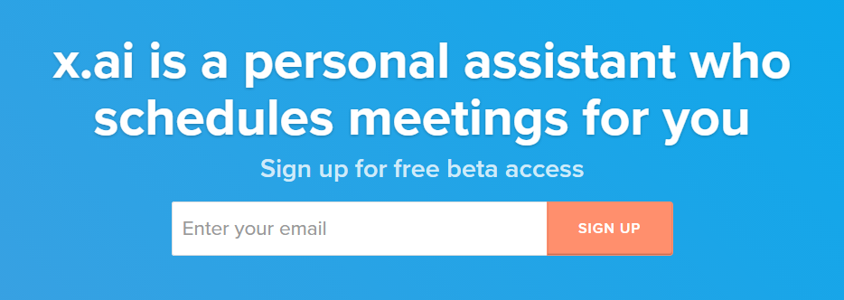
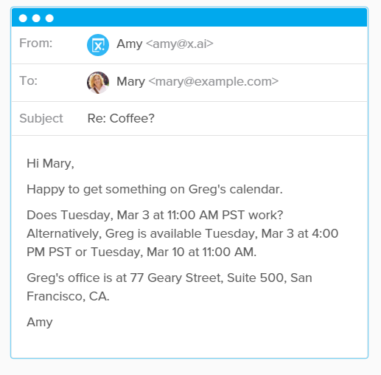

Slide 80
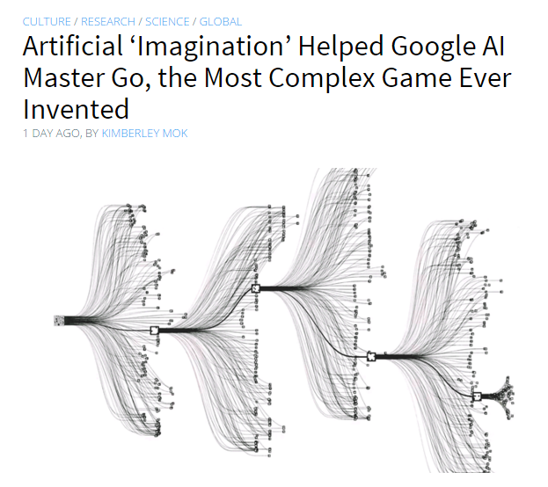
Machine Learning
Awesomeness Scale
Machine programs
itself to find, rank
and act on patterns
Machine Acts on Patterns
Machine Ranks Patterns
Machine Discovers Patterns
Excel Model
Excel Calc

Slide 81
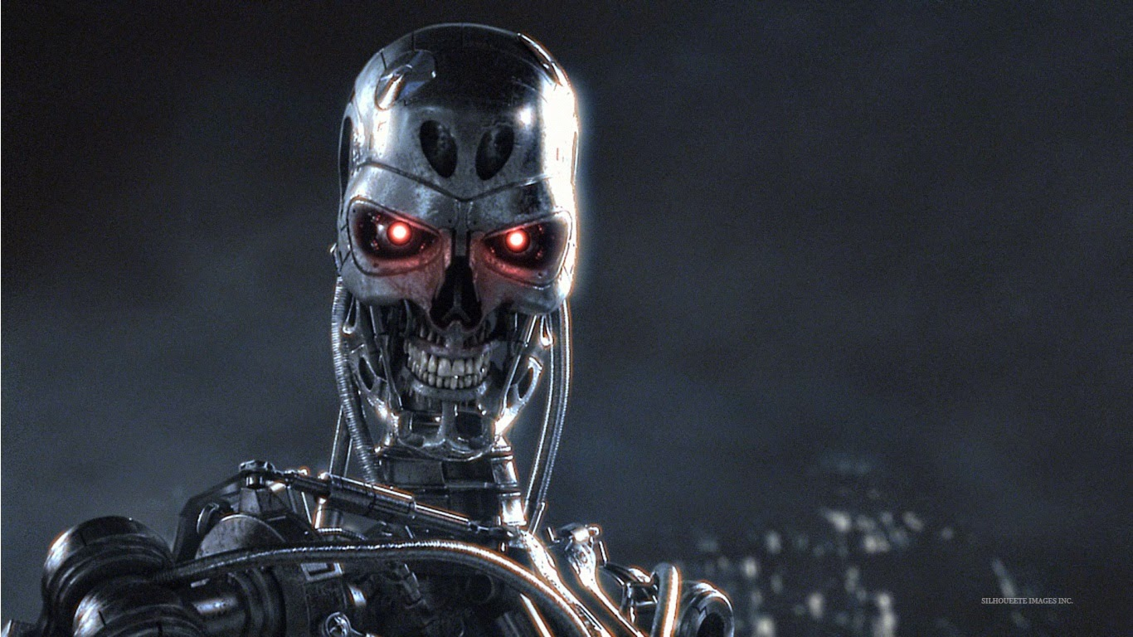
Machine programs
itself to find, rank
and act on patterns

Slide 82
Computers: fast yet dumb
People: slow yet smart
But

Slide 83
And

Slide 84
Machine Learning:
Autonomous hair-splitting
between good and bad
with no grasp of right and wrong.

Slide 85
Big data
More data than a human can wrangle
More attributes than a human can manage
More permutations than a human can comprehend
More complex algorithms than humans can write
Notes:
How do you get there? Depends on where you are today

Slide 86
So

Slide 87
But
so...
5 Things you can do to avoid the
Robot Zombie Apocalypse
Notes:
How do you get there? Depends on where you are today

Slide 88
Machine Learning
Does Not Happen in a Vacuum
1.
2.
3.
4.
5.

Slide 89
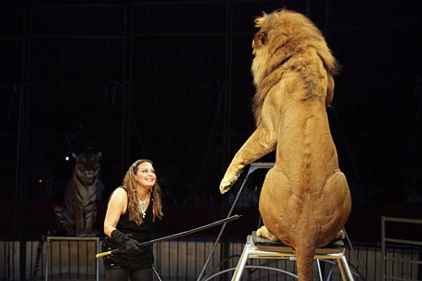
Machine Learning
Does Not Happen in a Vacuum
1. Be a machine teacher/enthusiast/proponent
2.
3.
4.
5.

Slide 90
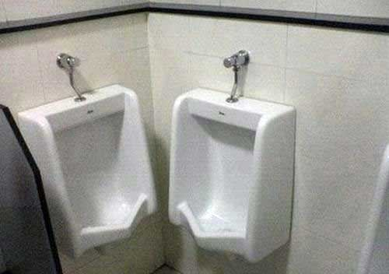
Machine Learning
Does Not Happen in a Vacuum
1. Be a machine teacher/enthusiast/proponent
2. Keep your eye on the big picture
3.
4.
5.

Slide 91
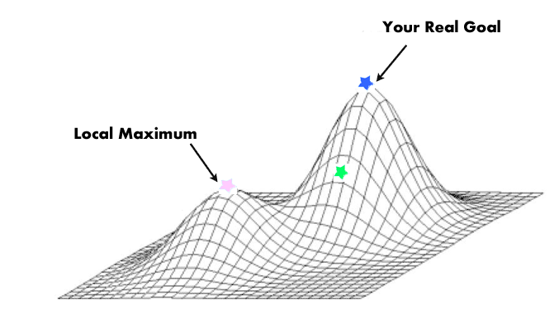
Machine Learning
Does Not Happen in a Vacuum
1. Be a machine teacher/enthusiast/proponent
2. Keep your eye on the big picture
3. Avoid the local maximum
4.
5.

Slide 92
Machine Learning
Does Not Happen in a Vacuum
1. Be a machine teacher/enthusiast/proponent
2. Keep your eye on the big picture
3. Avoid the local maximum
4. Know the business not just the numbers
5.

Slide 93
Machine Learning
Does Not Happen in a Vacuum
1. Be a machine teacher/enthusiast/proponent
2. Keep your eye on the big picture
3. Avoid the local maximum
4. Know the business not just the analytics
5. Push the machine

Slide 94
Machine Learning
Does Not Happen in a Vacuum
1. Be a machine teacher/enthusiast/proponent
2. Keep your eye on the big picture
3. Avoid the local maximum
4. Know the business not just the analytics
5. Push the machine

Slide 96
Machine Learning
Does Not Happen in a Vacuum
1. Be a machine teacher/enthusiast/proponent
2. Keep your eye on the big picture
3. Avoid the local maximum
4. Know the business not just the analytics
5. Push the machine

Slide 97
Machine Learning
Does Not Happen in a Vacuum
1. Be a machine teacher/enthusiast/proponent
2. Keep your eye on the big picture
3. Avoid the local maximum
4. Know the business not just the analytics
5. Push the machine
6. Recognize Insight

Slide 98
Jim Sterne
eMetrics Summit
Digital Analytics Association

